Slide 1
Informed delivery^{® year in review}
January 2025 – December 2025
Informed Delivery by USPS
Published Quarterly | Updated January 2026

Slide 2
Table of Contents
Executive Summary
Reach Millions of Users
Reach Engaged Users
Added Value
Package Campaigns

Slide 3

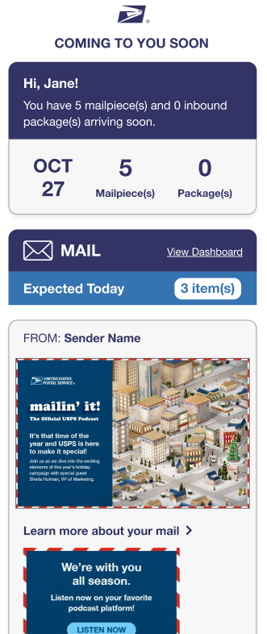


EXECUTIVE SUMMARY
The Informed Delivery® feature continues to provide value for brands by offering an additional touchpoint to re-engage customers, expand reach, and boost engagement.
  CONTINUED GROWTH
  STRONG EMAIL OPEN RATE
  VALUABLE IMPRESSIONS
The Informed Delivery user base has grown to 76.9M active users (+9.2% YoY).¹
Email open rate for Daily Digest emails has outpaced the industry average at above 60.6%. ¹
Informed Delivery campaigns have generated over 10.4B impressions², creating an opportunity for brands to expand their reach.
¹Internal data as of December 31, 2025
²Internal data from January 1, 2025 –December 31, 2025

Slide 4






SUMMARY OF KEY METRICS
Executive Summary
The numbers below summarize key metrics that make the Informed Delivery® feature a powerful digital marketing tool.
76.9
Million
Users¹
36.5
Billion
Impressions²
35.5%
National
Saturation¹
60.6%
Average Email Open Rate²
1,451,009
Campaigns Completed¹
2:36
Average Minutes Spent on Dashboard²
¹Internal data as of December 31, 2025
²Internal data between January 1, 2025 – December 31, 2025

Slide 5
GROWING USER BASE
Reach millions of users
With a growing user base of 76.9M active users, the Informed Delivery® feature provides brands an opportunity to reach a large population of highly engaged customers.
Registered Users
January 2025 – December 2025
Informed Delivery User Base
76.9M
Users
+9.2% Growth YoY
52.8M
Households
+8.2% Growth YoY
66.8M
Email-enabled Users
+9.8% Growth YoY
Internal data January 1, 2025 - December 31, 2025

Slide 6
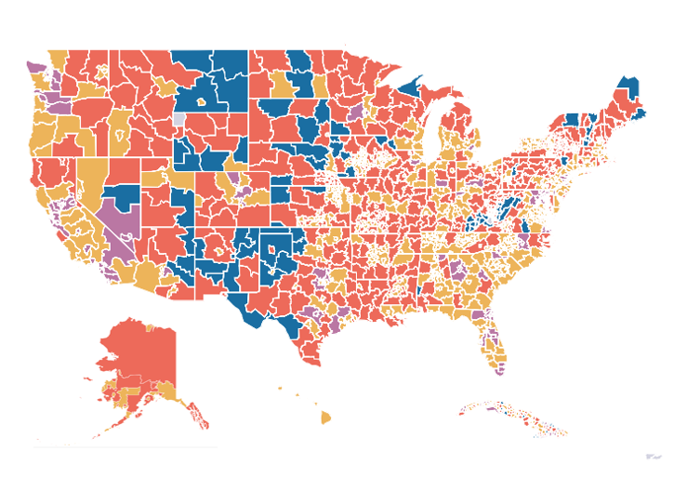

INFORMED DELIVERY® HOUSEHOLD SATURATION
Reach millions of users
The Informed Delivery feature has reached 35.5% national saturation of eligible delivery points.​
0 to 10%
10 to 20%
20 to 30%
30 to 40%
Over 40%
Internal data as of December 31, 2025

Slide 7

HIGH REACH AND ENGAGEMENT
REACH MILLIONS OF USERS
Impressive email open rates indicate that users are actively engaging with Informed Delivery® notifications.
Informed Delivery Daily Digest Emails
Brands can leverage Informed Delivery to reach this highly engaged audience…
15.1B
Total Daily Digest Emails Sent
9.1B
Total Daily Digest Emails Opened
Mailpieces
……….
Trend Line (Pieces)
Emails Sent
……….
Trend Line (Emails Sent)
Emails Opened
……….
Trend Line (Emails Opened)
Internal data between January 1, 2025 and December 31, 2025

Slide 8

Consistent user satisfaction
REACH ENGAGED USERS
User surveys indicate that 92% are satisfied or very satisfied with the feature and 79% are likely to recommend it to friends, family, or colleagues.
92% of users¹ are satisfied or very satisfied with the Informed Delivery® feature
79% of users¹ would recommend the
Informed Delivery feature to friends, family, or colleagues
¹Survey results collected from FY26 Q1 User Surveys

Slide 9

HIGH NET PROMOTER SCORE
REACH ENGAGED USERS
Users are highly likely to recommend the Informed Delivery® feature to others, leading to more awareness and a potential increase in the user base.
USPS
Net Promoter Score¹
Technology & Services
eCommerce
& Retail
Healthcare
70
66
59
53
²
Compared to NPS® scores for other industries³
¹The Net Promoter® Score (NPS) is an industry metric measured by asking users how likely they are to recommend a product, service or company to a friend or colleague. To calculate, visit NPS Calculator: Calculate and Benchmark Your Net Promoter Score (retently.com). Net Promoter® and Net Promoter Score® are registered trademarks of Bain & Company, Inc.
²Data from FY26 Q1 User Survey
³https://www.retently.com/blog/good-net-promoter-score/

Slide 10
Channel usage
Reach engaged users
Majority of Informed Delivery® users¹ access the Informed Delivery feature via Daily Digest email, followed by USPS.com®, and then the Informed Delivery Mobile app and USPS Mobile® App.
83% of Informed Delivery users access the Informed Delivery feature via the Daily Digest email
60.6%
Average Informed Delivery Daily Digest email open rate³
Email open rate more than double industry average²
¹Responses pulled from FY26 Q1 User Survey;
Note: Respondents were able to select more than one response type
²Email Open Rate: Email Open Rate: Statistics & 17 Best Practices (2025 Guide) | Mailmunch ³Internal data between January 1, 2025, and December 31, 2025

Slide 11


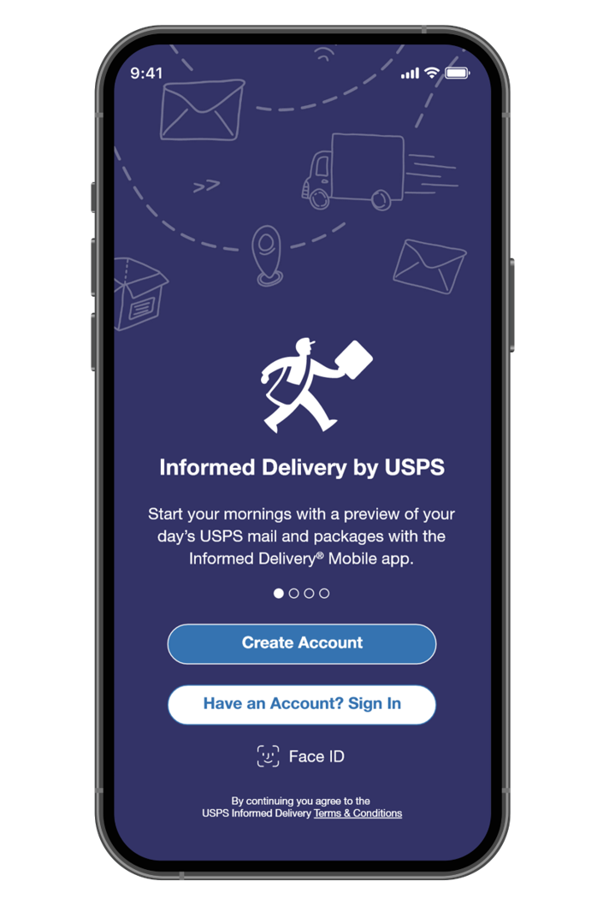
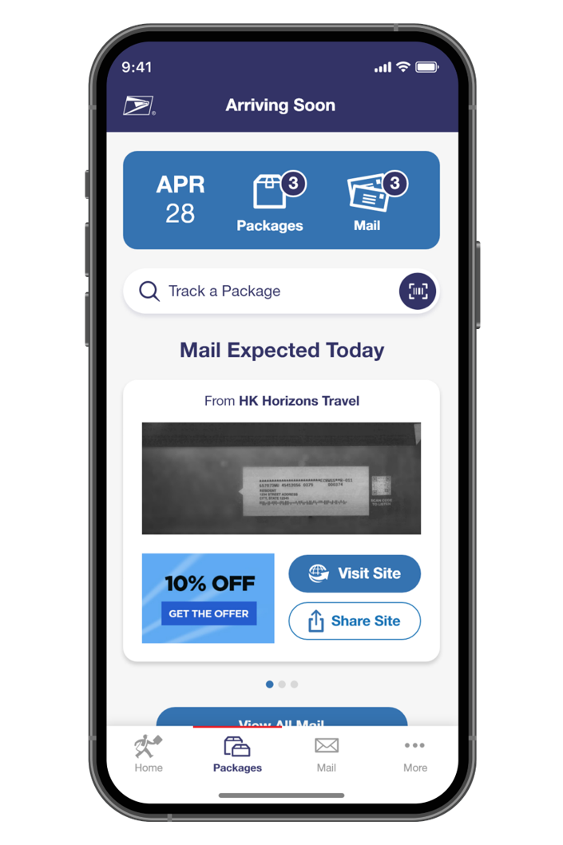
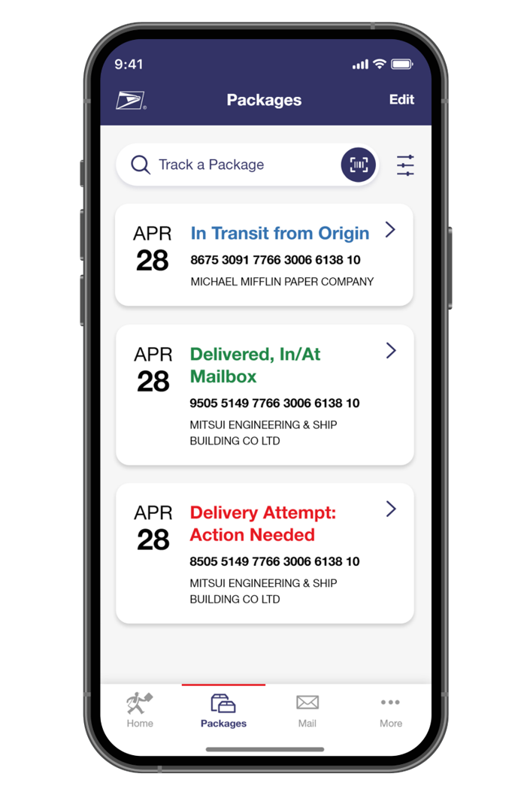

Id Mobile App
ADDED VALUE
The Informed Delivery Mobile app allows users to view their mail and package updates directly from their mobile device.
421,487¹
75,944¹
Total App Users
New ID Users from App
3.7M¹
Mobile Logins
164,758²
Active Users
4¹
Avg. All Time App Rating
¹Internal Data as of December 31, 2025
²Internal Data December 1, 2026 - December 31, 2025

Slide 12

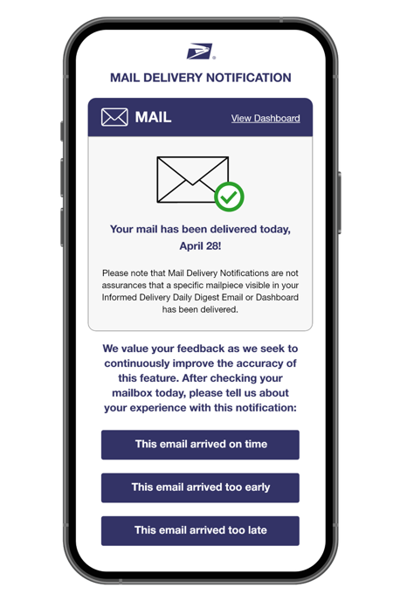
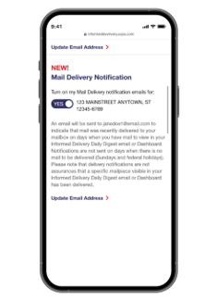
Mail delivery notification
ADDED VALUE
Current Enrollment & Stats
MDN sends an email notification alerting opted-in users that their daily letter mail has been delivered to their mailbox. ​
1,479,997
+311.6% YoY
Users Opted-In¹
57.4%
-11.5% YoY
Email Open Rate²
20,086,910
Emails Sent in Dec²
81.5%
-3.7% MoM
Say Email Arrived
On Time²
~18 min
+5.9% MoM
Average MDN Processing Time²
Mockup of MDN Email
Mockup of ID Settings Page
¹Internal Data as of December 31, 2025
²Internal Data from December 1 – December 31, 2025

Slide 13
On average, users spend more time on the Informed Delivery® dashboard than the median time spent on-page for 10+ industries.
Reach engaged users
Average of…
2:36 minutes
spent on the Informed Delivery dashboard¹
vs. 1:31 minutes median page view across sites of other industries²
¹Informed Delivery Feature Google Analytics Data December 31, 2025
²Website Traffic Benchmarks by Industry
13
© 2026 UNITED STATES POSTAL SERVICE

Slide 14
GENERATING SIGNIFICANT IMPRESSIONS
Reach engaged users
Daily Digest emails have generated 36 billion mailpiece and package impressions in the past year.
Impressions Delivered
January 2025 – December 2025
Total
Mail Impressions
33B
Total
Package Impressions
3B
Sum of Mailpiece Impressions
Sum of Package Impressions
Internal data from January 1, 2025 – December 31, 2025
Note: The Informed Delivery Program Office changed the way the data is collected. Package impressions are now based on unique package counts, previously package impressions were based on how many times a package was scanned during USPS processing.

Slide 15
HIGH EMAIL OPEN RATES
Reach engaged users
Informed Delivery® users are heavily engaged with their Daily Digest, as seen by the high email open rate of 61.8% in Q1 FY26. These impressions transform your customer’s inbox into a high-performing touchpoint.
61.8%
Q1 Daily Digest Email Open Rate
Internal data from January 1, 2025 – December 31, 2025
15
© 2026 UNITED STATES POSTAL SERVICE

Slide 16

MAIL CAMPAIGN IMPRESSIONS
Reach engaged users
Through the integration of hardcopy mail and digital marketing, the Informed Delivery® feature continues to provide increased impressions for mailers.
12,115,933,646
Emails sent with Campaigns
10,414,630,106
Individual Campaign Mailpieces
7,116,210,147
Emails Opened
16,332,799
Campaign Clicks
Internal data from January 1, 2025 – December 31, 2025
16
© 2026 UNITED STATES POSTAL SERVICE

Slide 17



INFORMED DELIVERY® AS A MARKETING CHANNEL
ADDED VALUE
Business mailers and shippers can engage users through an integrated mail or package digital marketing campaign that generates additional consumer impressions, interactions, and insights.
  Save Advertising Dollars
  Informed Delivery campaigns provide a free marketing channel for businesses to promote custom messages. Brands can elevate their hardcopy mail campaigns by pairing them with a digital experience at no additional cost.
  Expand Reach and Boost Engagement
  Campaigns allow brands to generate additional digital impressions for intended recipients. With over 76M¹ active users and an average email open rate of 60.6%², Informed Delivery provides brands an opportunity to reach an already engaged audience.
  Gain Customer Insights and Data
  Brands can leverage campaign data to gather insights on how customers interact with the brand, along with key performance metrics (i.e., open rates, click-through rates).
  Elevate the Customer Experience
  Customers can take action on their mail piece immediately—regardless of whether they retrieve mail from the physical mailbox. This in turn allows brands to see results faster than with traditional mailer campaigns.
To learn more about Informed Delivery campaigns, visit our Informed Delivery for Business Mailers and Shippers page.
¹Internal data as of December 31, 2025
²Internal data from January 1, 2025 – December 31, 2025

Slide 18
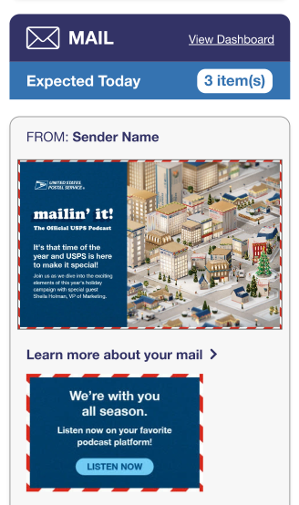
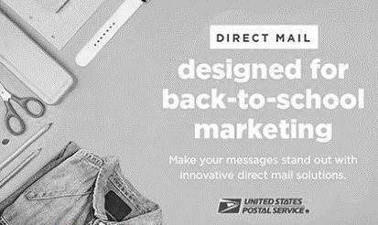
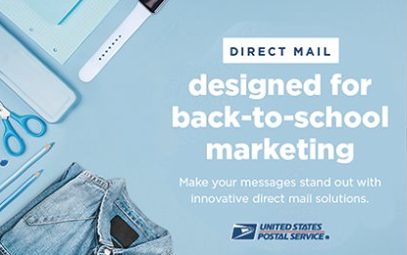
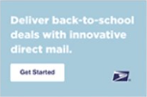
Opportunity for interactive campaigns
Added value
Mailers can create and launch interactive campaigns to reach and re-engage their customers.
Total # of Campaigns
January 2025 – December 2025
BASIC CAMPAIGN
DUAL CAMPAIGN
Click Through Rate
0.15%
Jane Doe
123 Main Street
Any town, USA ZIP
Click Through Rate
0.17%
Internal data from January 1, 2025 – December 31, 2025

Slide 19
calculate your potential Return on investment
Added value
Find out your potential return from a direct mail campaign that uses the Informed Delivery feature with our helpful Informed Delivery® Return on Investment Calculator here:
https://www.uspsdelivers.com/informeddelivery-calculator/
Discover the additional reach, attention, response, and conversions your direct mail campaign can garner by using the Informed Delivery feature.

Slide 20



PACKAGE CAMPAIGNS
Package campaigns
Shippers can also create and launch interactive campaigns to reach and re-engage their customers.
49,643Total Package Campaigns¹
137M+
Packages Associated to Campaigns¹
739K+
Total Click Throughs¹
0.54%
Click Through Rate¹
38.8%
Email Open Rate¹
¹Internal data from January 1, 2025 – December 31, 2025
Sign Up
Anyone interested in signing up for Package Campaigns should email us at IDPackageCampaigns@usps.gov.
For those seeking more information, check out the Shipper Campaign Portal (SCP) Guide on the Informed Delivery®
for Business Mailers website: https://www.usps.com/business/informed-delivery.htm
More Info
20
© 2026 UNITED STATES POSTAL SERVICE

